Slide 1
What does a healthy church look like?

Slide 2

Introduction
A computer only produces what’s been put in it. It might be able to mimic life but it cannot generate life. If you plant it in the ground it will never grow another computer. This is the secret of life, a divine principle of creation. This principle is not mechanical or technological, but natural.
When we are dealing with natural processes, it is important for this inherent potential to have free rein. You cannot make or force grass, trees, plants, or any other form of nature to grow, it is important to have the right environment and create the best possible conditions, for growth to happen all by itself.

Slide 3
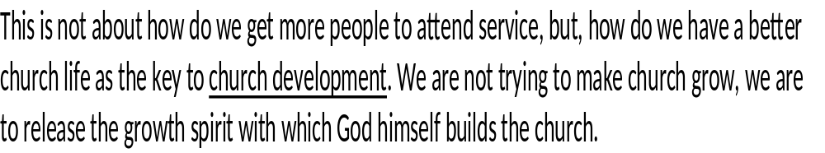


Slide 4
So, let’s look at 8 quality characteristics that should be in a healthy church
Samples of setting goals in ministry
6 quality activators

Slide 5
Empowered leadership
Leaders of quality growing churches concentrate on empowering other Christians for ministry.
These leaders realize their own empowerment by empowering others.
God’s energy and spirit, not human effort or pressure, is released to set the church in motion.

Slide 6
Gift based ministry
The role of Christian leadership is to help its members identify their gifts and integrate them into appropriate ministries.
When Christians function in their area of giftedness, they generally function less in their own strength and more in the power of the Holy Spirit.
People tend to not get burned out using their gifts.

Slide 7
Passionate Spirituality
Do the people in church live committed lives and practice their faith with joy and enthusiasm?
If the church is not praying and leaders do not have a corporate prayer time, and individual times of pray, that church does not have spiritual passion.
Spiritual passion is to live it out with contagious enthusiasm. This happens with prayer and the personal use of the bible.

Slide 8
Effective structures
This is the development of structure that promotes an ongoing multiplication of ministry.
Without structure you will create times where feelings and emotions take over as a move of God and it is a move of emotions.

Slide 9
Inspired Worship
Simply put, is worship service an inspiring experience for the participants?
This worship is not just from people who sings, but from people who believes in who they sing about.

Slide 10
Small/cell groups
Holistic small groups are the natural place for the Christian to serve others both inside and outside of the groups. The four areas of Christian development is: public- social – Private and Intimate
Groups could be as small as 3 but should be limited to 12 -15
The planned, multiplications of small groups are made possible through the continual development of leaders.

Slide 11
Need oriented evangelism
What are the needs of the non-Christians in our area?
This characteristic of a healthy church is to challenge Believers to build relationships with the unchurched and use already formed relationships with the unchurched as contacts for evangelism.

Slide 12
Loving relationships
Our love quotient must be high in order to have quality growth in the church.
New comers and visitors must know you care if they are to come back to church.
To make this point very clear, more than a revival, evangelistic crusade, or the practice of spiritual warfare (as important as they maybe), there is a significant connection between love and laughter in the church and the health and growth quality of the church.

Slide 13
Samples of setting goals for the ministry

Slide 14
Empowered leadership
Have a 6 hour servant hood leadership training class this year for potential leaders
Have a three hour small group leadership training class twice a year
Each small group to identify two potential leaders 2nd quarter

Slide 15
Gift based ministry
Have a gift assessment session with your leaders to determine the gifts of the leaders.
75% of the leaders should be reassigned/assigned by the 2nd quarter
Have a gift assessment for all new members as part of the new members class

Slide 16
Small/cell groups
Have five new groups this year
Develop groups where young men and women are in their own groups by the fifth month of the year.

Slide 17
Need oriented evangelism
Identify 3 needs in the community first quarter
Discuss the best way to meet at least two of the three before the quarter is over
Every leader befriends a neighbor in the community they live or work in, in the first quarter

Slide 18
Loving relationships
Every couple attend at least one marriage workshop this year.
Pastors, don’t eat alone twice a month. Eat with one of your leaders and their family or with a congregant that is a potential leader.
Leaders, have lunch with some of the new believers

Slide 19
6 quality activators

Slide 21
Interdependence
Each characteristic of the healthy church works together and they affect one another.
Department heads of the church should meet regularly for discussions.

Slide 22
Multiplication
The true fruit on an apple tree is not an apple but another apple tree. The true fruit of a small group is not a Christian but another small group. The true fruit of a leader is not a follower but another leader. The true fruit of a church is not a small group or a mission, but another church.
Are the leaders making leaders The great commission is a call for ongoing multiplication.
This form of growth surpasses its own individuality.

Slide 23
Energy transformation
It is how we handle crises and catastrophes.
We cannot be passive when things go wrong in the ministry, nor can we obstinately protest against it. (satan did it). But ask the question, how can we best use this situation for the advancement of God’s Kingdom? This is a creative question to ask. The promise in Rom. 8:28

Slide 24
Sustainability
The principle of co-leadership is not investing in leadership only, and training programs to develop leaders, but the actual participation in leadership provides the best training for new leaders. OJT

Slide 25
Symbiosis
We cannot afford to be believe that unity is when everyone looks the same, acts the same and responds the same way. That monopolistic system is ineffective and destructive at best. It may show signs of growth initially. But studies have shown that the underlying corrosion is more destruction and vast producing than an apparent initial numerical growth. However, when two dissimilar organisms coexist in an intimate close environment for a mutual benefit, it is called symbiotic. It is important that love be without dissimilation. Everyone must be accepted with love.

Slide 26
Fruitfulness
Both in the biological since and the biblical since, all of God’s creation is designed to bear fruit.
Where no fruit appears, something is wrong. We must periodically examine our fruitfulness.
What is useful must be that which edifies (builds up), for what is useful, must be fruitful.

